Slide 1
Microsoft New Original Content
Insight into current box off trends.

Slide 2
Introduction
My name is Rusty Brown, and I am a lead data scientist on this project. And yes, I’m that nerdy type who never liked presenting in front of groups of people. I would rather stay in my den and write code all day long.

Slide 3
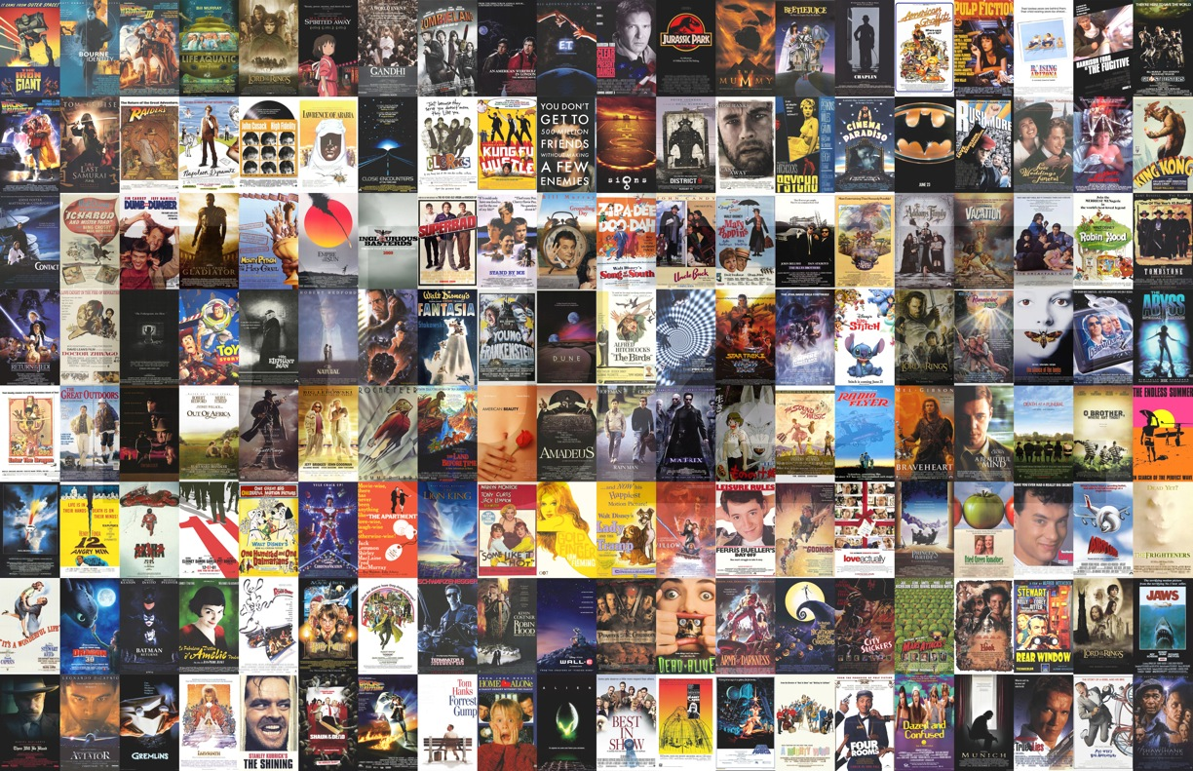
Where To Start?
Title | Release Year | Genres
Sunghursh | 2013 | Action,Crime,Drama
One Day Before the Rainy Season | 2019 | Biography,Drama
The Other Side of the Wind | 2018 | Drama
Sabse Bada Sukh | 2018 | Comedy,Drama
The Wandering Soap Opera | 2017 | Comedy,Drama,Fantasy
... | ... | ...
Kuambil Lagi Hatiku | 2019 | Drama
Rodolpho Teóphilo - O Legado de um Pioneiro | 2015 | Documentary
Dankyavar Danka | 2013 | Comedy
6 Gunn | 2017 | None
Chico Albuquerque - Revelações | 2013 | Documentary
146144 Movies
With IMDB listing nearly 150,000 movie titles, it can be hard to determine where to start.
We will will look at the top grossing movies and analyze some trends to give you a better understanding of the market.

Slide 4
Our Focus
General Genre Trends
What genre trends appear in the top grossing films?
Subgenre Trends
Are some subgenres more prevalent than others?
Runtime analysis
How long are the top grossing movies?

Slide 5
Genre Trends
Genre Count Trends

Slide 6
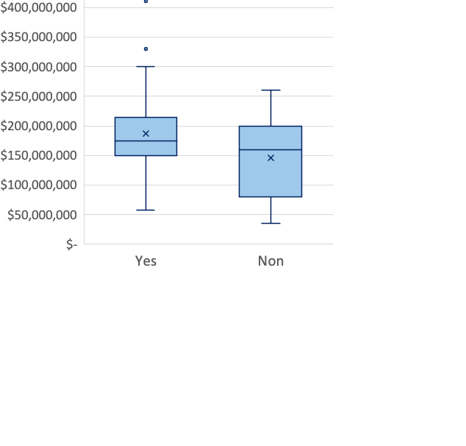
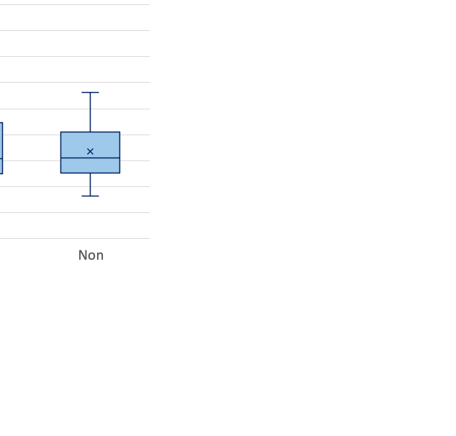
Genre Trends – Action Films
Asdf
Sadf
Asdf
sadf

Slide 7
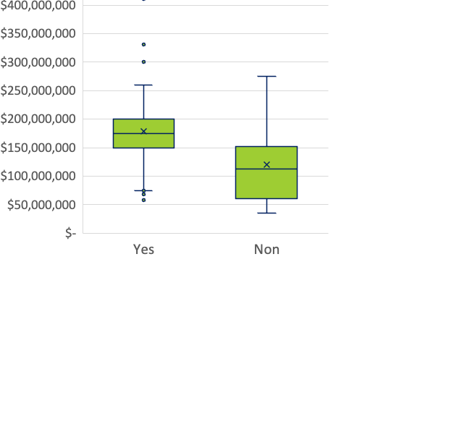
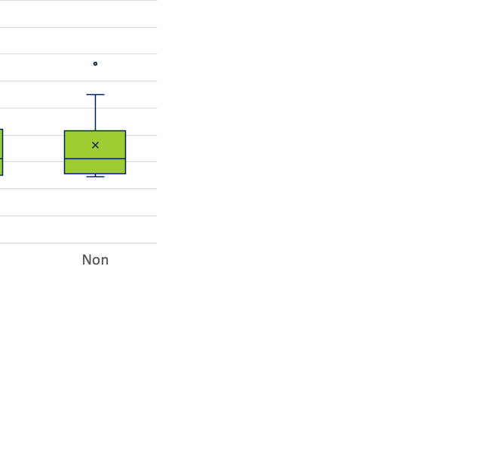
Genre Trends – Adventure Films
Asdf
Sadf
Asdf
sadf

Slide 8
Subgenre Trends
Genre Count Trends

Slide 9
Genre Trends – Action Films
Asdf
Sadf
Asdf
sadf

Slide 10

Genre Trends – Adventure Films
Asdf
Sadf
Asdf
sadf

Slide 11

Questions?

Slide 12

Contact
Address
4508 Swingster Ln, Sachse, Texas
Contact Number
(405)207-6766
Email
jonathan.r.brown32@gmail.com

